Slide 1
Small Business Event
Best Practices
Alvie Johnson
Presented at AFCEA WEST

Slide 2
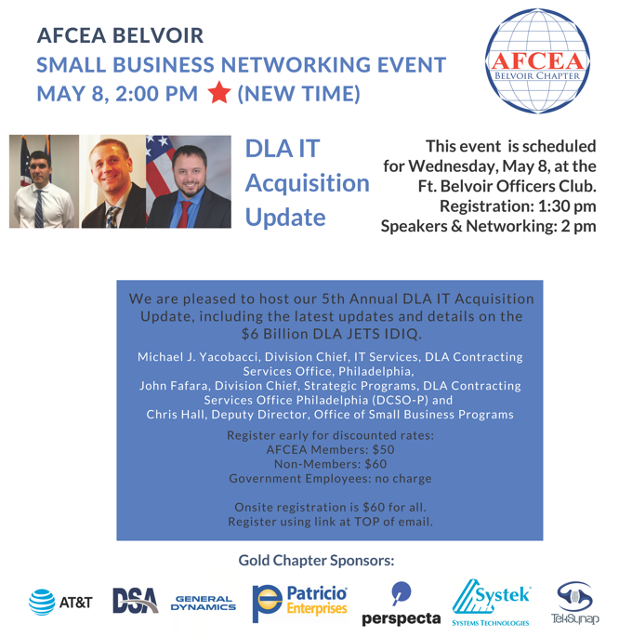
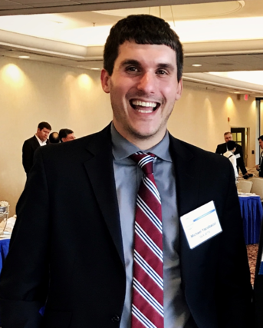
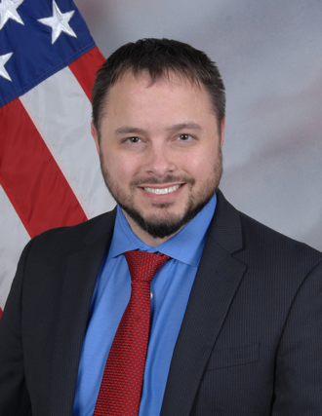
TIP: Attendees want to hear FROM decision-makers ABOUT opportunities!

Slide 3
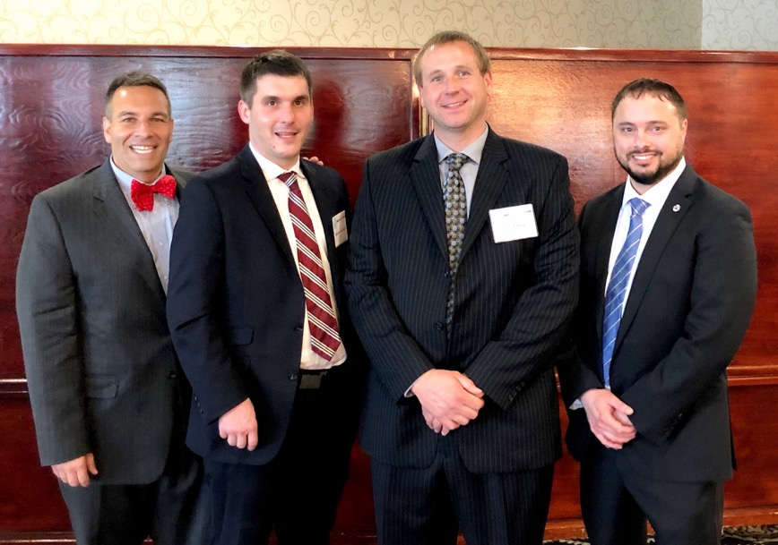
Approach to Building the AFCEA Belvoir Chapter’s SB Program:
TIP: Have FUN!

Slide 4
Approach to Building the AFCEA Belvoir Chapter’s SB Program:
TIP: Don’t be afraid to TRY SOMETHING NEW!

Slide 5
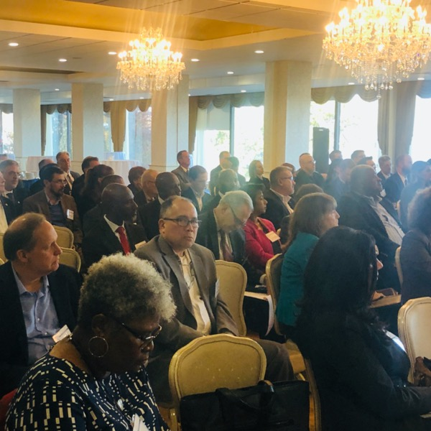
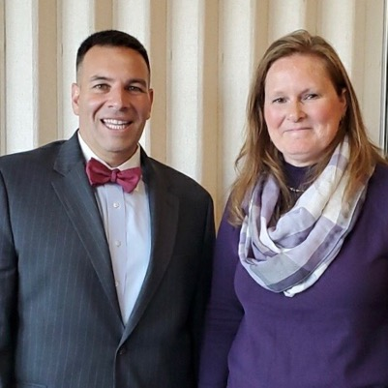
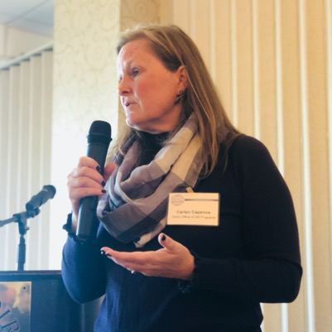
Approach to Building the AFCEA Belvoir Chapter’s SB Program:
TIP: KNOW your TARGET MARKET and cater your SB programs to them.

Slide 6
In Summary:
Attendees want to hear FROM decision-makers ABOUT opportunities!
Have FUN!
Don’t be afraid to TRY SOMETHING NEW!
KNOW your TARGET MARKET and cater your SB programs to them.

